Slide 1



Proof of Concept
PROOF OF
CONCEPT
NAME: TANUSHRI DAS
PGPDSBA’20-21
Name :

Slide 2
This report documents the implementation and results of Exploratory Data Analysis proof of concept applied on YouTube data to promote a Fashion, Beauty and lifestyle channel.
The objective of this assignment was to analyze the different trends of this category in order to facilitate growth of the channel in terms of views, engagement and subscribers.
The assessment found some useful insights which helped in the overall growth of the channel.

Slide 3
Aim: Increase reach of the channel. Attracting people to view videos and increase engagement
Understanding YouTube Algorithm:
Find the right video for each viewer, and get viewers to keep watching
Search results and recommendation streams
Your video’s metadata (title, description, keywords) and how well those match the user’s query
Your video’s engagement (likes, comments, watch time)

Slide 4
Channel category: Indian Fashion, Beauty and Lifestyle
Approach:
Top 6 Youtubers: Sejal Kumar, Komal Pandey, Perkymegs, Myhappinesz, Jovita George and SuperPrincessjo
Data Gathering : Web srapping, 100 videos each
Data cleaning : NLP techniques
Perform EDA

Slide 5


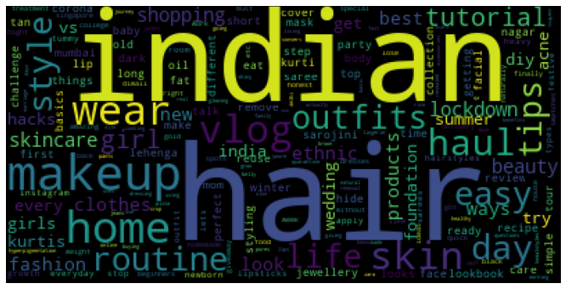
Title Keywords

Slide 6
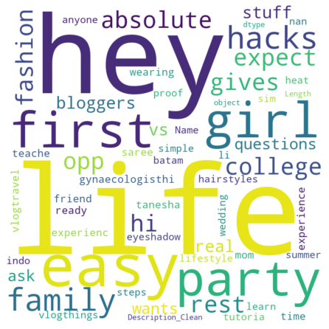
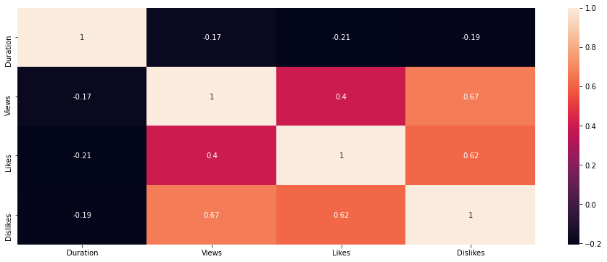
Tag Keywords
Correlation Plot

Slide 7
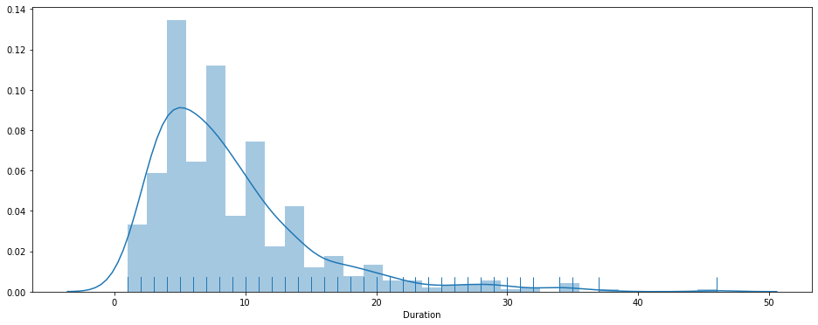
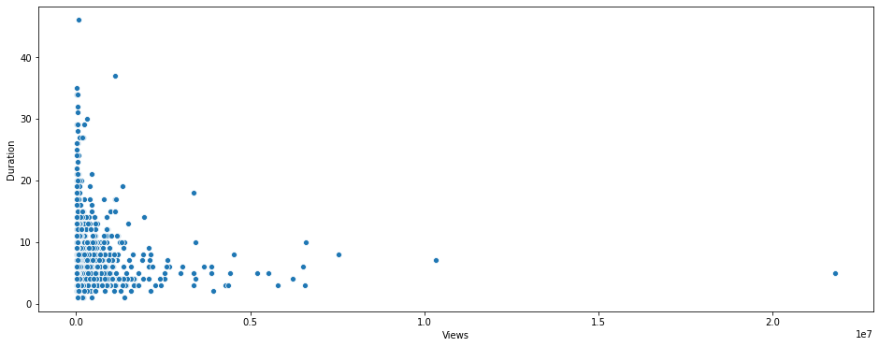
Duration
Duration vs Views

Slide 8
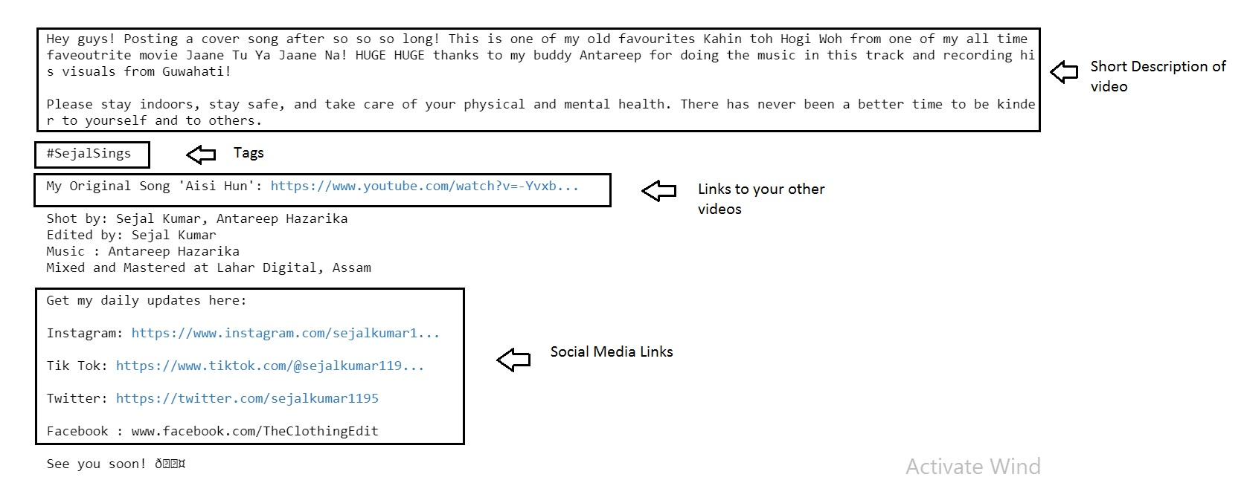
Description Format

Slide 9
The most loved videos had titles containing words Indian, hair, makeup, home, routine, skin, beauty, haul, outfits, style, tutorial
Proper Format of Title (“ ” | Channel Name)
Proper Description Format
Duration: 5-10 mins
Keyword rich tags

Slide 10
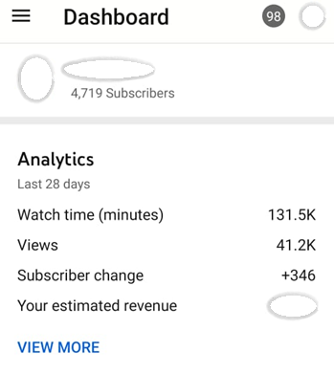
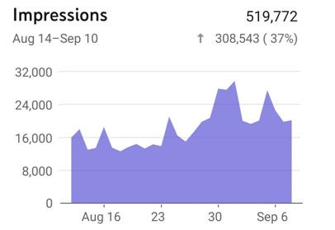
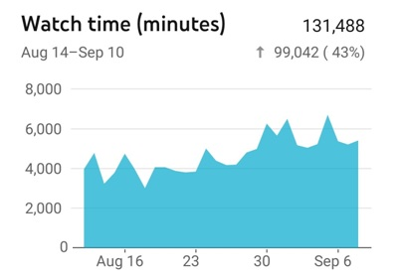
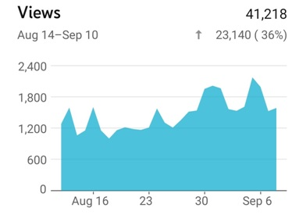
Impressions
Subscribers
Views
Watch time

